Slide 1
Chapter 2
Understanding Objects in Java
Part I

Slide 2
Learning Objectives
To apply program structure in Java;
To construct objects and variables; and
To construct method calls.

Slide 3
Object-Oriented Approach
Designs a program as collections of interacting objects that work together to accomplish tasks.
Model the world as it is.
The main concepts OO:
  Objects, Classes and Instances
  Attributes and operations (behaviour)
  Object State
  Message-passing and methods

Slide 4
What Is an Object?
An object is a thing, both tangible and intangible. Account, Vehicle, Employee, etc.
“Objects have state, behaviour and identity.”
  State: the condition of an object at any moment, affecting how it can behave
  Behaviour: what an object can do, how it can respond to events and stimuli
  Identity: each object is unique
Objects are categorized into classes
Each individual object is an instance of a class

Slide 5
What Is a Class?
To create an object inside the computer program, we must provide a definition for objects—how they behave and what kinds of information they maintain —called a class.
Class - a category of objects that share the same:
  attributes,
  operations/methods
Notes:
We don’t go into relationships and semantics at all here. Nor do we discuss attributes, operations and methods in any detail. All will be covered more extensively in later material, but lecturers may wish to add more explanation here.

Slide 6
What Is an Attribute?
Attribute- a named property of a class that describes a range of values that instances of the attribute might hold.
Attributes are the way classes encapsulate data

Slide 7
What Is an Operation?
A behavior of an object
Implemented in classes are methods
Methods are identified and invoked by their signatures, including name, parameters, and return type

Slide 8
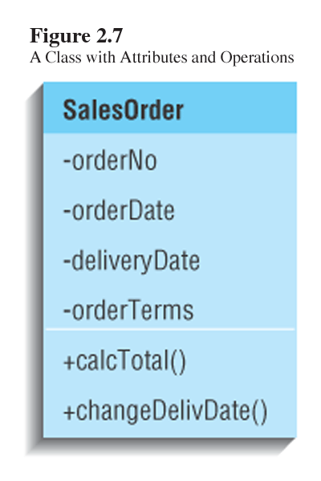
Graphical Representation of a Class

Slide 9
Message and Methods
To instruct a class or an object to perform a task, we send a message to it.
You can send a message ONLY TO the classes and objects that understand the message you sent to them.
A class or an object must possess a matching method to be able to handle the received message.
A method defined for a class is called a class method, and a method defined for an object is called an instance method.
A value we pass to an object when sending a message is called an argument of the message.
Notes:
An object is not a passive container of information. Rather, it is an active entity capable of carrying out tasks. Tasks such as deducting a withdrawal amount from an account, computing the shortest route from your dorm to a classroom, and so forth.
To command an object (or a class) to do something, we send a message to it.
Not all objects (and classes) can respond to any messages sent them. They must be programmed to recognize messages. In other words, we define methods. Once a method is defined, then we can send a matching message. For example, we define a method, say, move to a MobileRobot object. Once this method is programmed correctly, then we can send a message to a MobileRobot object to move.

Slide 10
Sending a Message
Message deposit with the argument 250.00 is sent to a BankAccount object SV198.
deposit 250.00
SV198 : BankAccount
Notes:
Here’s an example of sending a message. This slide shows a sending of the message deposit to SV198. The BankAccount class must include a method named deposit. Otherwise, there will be an error because SV198 won’t be able to recognize the message.
The name of the message we send to an object or a class must be the same as the method’s name.
Because they are the same, the phrase “calling an object’s method” is synonymous to “sending a message to an object.”

Slide 11
Class and Instances Data Values
An object is comprised of data values and methods.
Data values are also called data members (belongs to a class or instance of a class)
An instance data value is used to maintain information specific to individual instances. For example, each BankAccount object maintains its current balance.
A class data value is used to maintain information shared by all instances or to represent collective information about the instances.
For example, minimum balance is the information shared by all Account objects.
Two types of data values: variable – a data value that can change, constant – one that cannot change
Notes:
Every object from the same class will have the same set of data values. The values themselves for individual objects would be different, of course.
We assume here that the minimum balance is the same for all accounts. If this is the case, then the single value for minimum balance is shared by all Account objects. So we need to keep one value of the minimum balance that will be shared by all Account objects.

Slide 12
Sample Instances Data Values
public class BankAccount {
// Class data value static double minimum_balance = 100.0;
//Instance data value
double current_balance;
……..
}

Slide 13
Sample Instances Data Values
SV129 : BankAccount
SV098 : BankAccount
SV211 : BankAccount
current balance
current balance
current balance
908.55
1304.98
354.00
All three BankAccount objects possess the same instance data value current balance.
The actual dollar amounts are, of course, different.
Notes:
Here we see that all instances of the BankAccount class has a data value named current balance.
Although only one instance data value is shown here, it does not mean these objects contain only one data value. Most likely the real BankAccount objects would include about a dozen or so instance data values. We only show a single instance data value here so the diagram would not become cluttered.

Slide 14
Sample Instances Data Values
BankAccount
There is one copy of minimum balance for the whole class and shared by all instances.
minimum balance
100.00
This line is an instance-of relationship.
SV129 : BankAccount
SV098 : BankAccount
SV211 : BankAccount
current balance
current balance
current balance
908.55
1304.98
354.00
Notes:
Here we see that a single class data value named minimum balance is shared by all instances. The dotted lines show the three objects are instance of the BankAccount class.
To see the significance of a class data value, consider the situation where the minimum balance is represented as an instance data value. Because there’s only one value for the minimum balance, defining it as an instance data value would result in maintaining three copies of the same value, one copy per object. This is a waste of memory space. Not only that, more critically, keeping duplicates in memory will complicate the processing. When we have to change the value for the minimum balance, for example, we have to locate all copies and update them. Imagine updating the duplicates copies of 1000 BankAccount objects. This is a very time consuming and error-prone activity, which can be avoided easily by representing the information as a class data value.

Slide 15
Characteristic Of Object-Oriented Programming
Abstraction
Encapsulation
Inheritance
Polymorphism
Aggregation
Composition

Slide 16
Abstraction
Characteristic Of Object-Oriented Programming
Abstraction is the process of finding the essential feature set for a class.
Concentrating on what an object is and does before making any decision about how the object will be implemented.
Capture the attributes and operation of a object/real-world deck.

Slide 17
Encapsulation
Characteristic Of Object-Oriented Programming
Encapsulation is the process of hiding object data and providing methods for data access (data and behavior are bundled into a class and hidden from the outside world)
Each object of a class has its own set of instance fields. Instance fields are declared with the access modifier private, public or protected.
Access to the data and behavior is provided and controlled through an object’s interface

Slide 18
Inheritance
Characteristic Of Object-Oriented Programming
Inheritance is a fundamental object-oriented design technique used to create and organize reusable classes
Inheritance allows a software developer to derive a new class from an existing one
The existing class is called the parent class, or superclass, or base class
The derived class is called the child class or subclass
As the name implies, the child inherits characteristics of the parent
A subclass inherits accessible data fields and methods from its super class, and may also add new data fields and methods.

Slide 19
Inheritance…
Characteristic Of Object-Oriented Programming
Example:
Cylinder class and Sphere class derived from Circle class are called as subclasses, while Circle class is called a super class.
Circle
Super class
Sphere
Cylinder
Subclass

Slide 20
Polymorphism
Characteristic Of Object-Oriented Programming
Polymorphism is an object-oriented concept that allows us to create versatile software designs that deals with multiple objects.
The term polymorphism literally means "having many forms“ – can refer to multiple types of related objects over time in consistence way.
A polymorphic reference is a variable that can refer to different types of objects at different points in time
An object reference can refer to an object of its class, or to an object of any class related to it by inheritance
Notes:
Polimorfisma bermakna banyak bentuk

Slide 21
Polymorphism…
Characteristic Of Object-Oriented Programming
For example, if the Holiday class is used to derive a class called Christmas, then a Holiday reference could be used to point to a Christmas object
Holiday
Holiday day;
day = new Christmas();
Christmas
Notes:
Polimorfisma bermakna banyak bentuk

Slide 22
Aggregation
Characteristic Of Object-Oriented Programming
Aggregation is a special form of association that represents an ownership relationship between two classes
Models has-a relationship
In Java, an object is an aggregate of another member object if:
  it has a field reference to the member object
  the member object can exist independently

Slide 23
Composition
Characteristic Of Object-Oriented Programming
Aggregation is a stronger form of association in which the composition has sole responsibility for managing its part.
In Java, an object is an composite of another object part if:
  it has a field reference to the object part;
  the object part cannot exist independently;

Slide 24
Aggregation & Composition
Characteristic Of Object-Oriented Programming
Example:
Name
Person
Address
composition
aggregation

Slide 25
Aggregation & Composition
Characteristic Of Object-Oriented Programming
Example:
Public class Name{
/** Data field omitted*/
/**Constructors omitted */
/**Methods omitted*/
}
Public class Person{
/** Data field omitted*/
private Name name;
private Address address;
/**Constructors omitted */
/**Methods omitted*/
}
Public class Address{
/** Data field omitted*/
/**Constructors omitted */
/**Methods omitted*/
}

Slide 26
The Basics of Java Program
Basic unit of a Java program – class
  Therefore application is a collection of one or more classes.
  A class is a collection of methods and data members
One of the classes in a Java application program must have only one method main.

Slide 27
A Simple Java Program
//This program prints Welcome to Java!
public class Welcome {
public static void main(String[] args) {
System.out.println("Welcome to Java!");
}
}

Slide 28
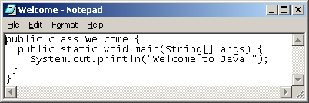
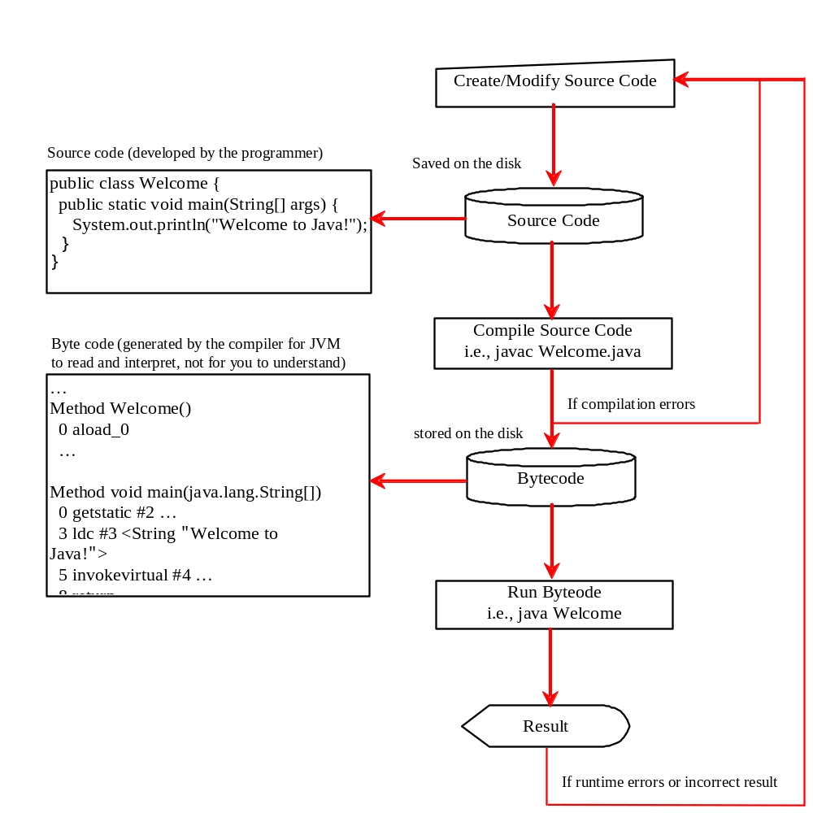
Creating, Compiling, and Running Programs

Slide 29
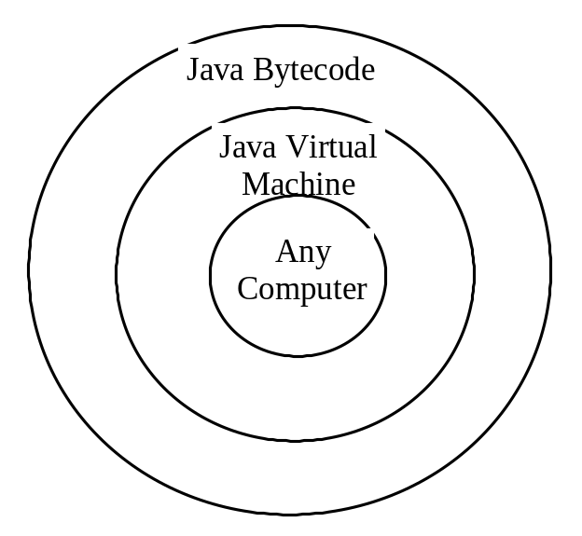
Compiling Java Source Code
You can port a source program to any machine with appropriate compilers. The source program must be recompiled, however, because the object program can only run on a specific machine. Nowadays computers are networked to work together. Java was designed to run object programs on any platform. With Java, you write the program once, and compile the source program into a special type of object code, known as bytecode. The bytecode can then run on any computer with a Java Virtual Machine, as shown below. Java Virtual Machine is a software that interprets Java bytecode.

Slide 30
Trace a Program Execution
Enter main method
//This program prints Welcome to Java!
public class Welcome {
public static void main(String[] args) {
System.out.println("Welcome to Java!");
}
}

Slide 31
Trace a Program Execution
Execute statement
//This program prints Welcome to Java!
public class Welcome {
public static void main(String[] args) {
System.out.println("Welcome to Java!");
}
}

Slide 32

Trace a Program Execution
//This program prints Welcome to Java!
public class Welcome {
public static void main(String[] args) {
System.out.println("Welcome to Java!");
}
}
print a message to the console

Slide 33
Anatomy of a Java Program
Class name
Main method
Statements
Statement terminator
Reserved words
Comments
Blocks

Slide 34
Class Name
Every Java program must have at least one class. Each class has a name. By convention, class names start with an uppercase letter. In this example, the class name is Welcome.
//This program prints Welcome to Java!
public class Welcome {
public static void main(String[] args) {
System.out.println("Welcome to Java!");
}
}

Slide 35
Main Method
Line 2 defines the main method. In order to run a class, the class must contain a method named main. The program is executed from the main method.
//This program prints Welcome to Java!
public class Welcome {
public static void main(String[] args) {
System.out.println("Welcome to Java!");
}
}

Slide 36
Statement
A statement represents an action or a sequence of actions. The statement System.out.println("Welcome to Java!") in the program in Listing 1.1 is a statement to display the greeting "Welcome to Java!“.
//This program prints Welcome to Java!
public class Welcome {
public static void main(String[] args) {
System.out.println("Welcome to Java!");
}
}

Slide 37
Statement Terminator
Every statement in Java ends with a semicolon (;).
//This program prints Welcome to Java!
public class Welcome {
public static void main(String[] args) {
System.out.println("Welcome to Java!");
}
}

Slide 38
Reserved words
Reserved words or keywords are words that have a specific meaning to the compiler and cannot be used for other purposes in the program. For example, when the compiler sees the word class, it understands that the word after class is the name for the class.
//This program prints Welcome to Java!
public class Welcome {
public static void main(String[] args) {
System.out.println("Welcome to Java!");
}
}

Slide 39

Blocks
A pair of braces in a program forms a block that groups components of a program.

Slide 40

Special Symbols

Slide 41
{ … }
// This program prints Welcome to Java!
public class Welcome {
public static void main(String[] args) {
System.out.println("Welcome to Java!");
}
}

Slide 42
( … )
// This program prints Welcome to Java!
public class Welcome {
public static void main(String[] args) {
System.out.println("Welcome to Java!");
}
}

Slide 43
;
// This program prints Welcome to Java!
public class Welcome {
public static void main(String[] args) {
System.out.println("Welcome to Java!");
}
}

Slide 44
// …
// This program prints Welcome to Java!
public class Welcome {
public static void main(String[] args) {
System.out.println("Welcome to Java!");
}
}

Slide 45
" … "
// This program prints Welcome to Java!
public class Welcome {
public static void main(String[] args) {
System.out.println("Welcome to Java!");
}
}

Slide 46
Programming Errors
Syntax Errors
  Detected by the compiler
Runtime Errors
  Causes the program to abort
Logic Errors
  Produces incorrect result

Slide 47
Syntax Errors
public class ShowSyntaxErrors {
public static main(String[] args) {
System.out.println("Welcome to Java);
}
}

Slide 48
Runtime Errors
public class ShowRuntimeErrors {
public static void main(String[] args) {
System.out.println(1 / 0);
}
}

Slide 49
Logic Errors
public class ShowLogicErrors {
public static void main(String[] args) {
System.out.println("Celsius 35 is Fahrenheit degree ");
System.out.println((9 / 5) * 35 + 32);
}
}

Slide 50
Problem
Find the sum of integers from 1 to 10, from 20 to 30, and from 35 to 45, respectively.

Slide 51
Solution
int sum = 0;
for (int i = 1; i <= 10; i++)
sum += i;
System.out.println("Sum from 1 to 10 is " + sum);
sum = 0;
for (int i = 20; i <= 30; i++)
sum += i;
System.out.println("Sum from 20 to 30 is " + sum);
sum = 0;
for (int i = 35; i <= 45; i++)
sum += i;
System.out.println("Sum from 35 to 45 is " + sum);

Slide 52
Q & A

